Slide 1
HH
HouseHub
House Rental Management System
Software Engineering | Course Code: 3112 | Session: 2022-23
SUBMITTED BY
SUBMITTED TO
Member 1
Punom Das Momo
ID: 202204031
Abdullah Al Siam
Lecturer
Member 2
Foujia Akther
ID: 202204009
Chairman of CSE department
Netrakona University
Member 3
Mansora Akther Mim
ID: 202104028
Department of Computer Science & Engineering | Netrakona University
Notes:
Cover slide. Introduce the project, team members and the supervising lecturer.

Slide 2
SLIDE 02 | TEAM
Team Work Division
Member 1
Member 2
Member 3
Punom Das Momo
Foujia Akther
Mansora Akther Mim
ID: 202204031
ID: 202204009
ID: 202104028
User Registration
Add / Edit / Delete Listing
Search & Filter System
Login & JWT Token
Image Upload (Multer)
Interest Request System
Password (bcrypt)
Listing Details Page
Accept / Reject Flow
Role-based Access
Admin Dashboard
Wishlist — Save & Remove
Version Control: Git & GitHub | Each member works on a separate branch | Pull Requests for merging
Notes:
Show clearly who did what. Mention that GitHub is used for collaboration.

Slide 3
SLIDE 03 | BACKGROUND
The Problem We Are Solving
Current Situation (Problem)
HouseHub Solution
X
Walk area to area asking locals
V
One platform for owners & tenants
X
Brokers charge extra commission
V
Post listings with photos & details
X
Facebook groups - no filter
V
Filter by area, price, room type
X
Cannot compare multiple options
V
Interest request - no broker needed
X
Owners lack a proper ad platform
V
Wishlist to compare & revisit
X
No verified contact system
V
Contact shown only after approval
Notes:
Start with the real problem to build context for why HouseHub is needed.

Slide 4
SLIDE 04 | OVERVIEW
What is HouseHub?
HouseHub is a full-stack web application that connects house/room owners with tenants on a single platform — offering listing management, smart search, interest requests, and a wishlist system with role-based access for Owner, Tenant and Admin.
OWNER
TENANT
ADMIN
Owner
Tenant
Admin
Post, edit & delete listings
Browse & filter listings
View all users & listings
Upload property photos
Save listings to Wishlist
Block / unblock any user
Accept or reject tenant requests
Send interest requests
Remove inappropriate listings
Track all incoming interests
Track own request status
Monitor platform activity
Notes:
Three distinct roles keep the system secure and organised.

Slide 5
SLIDE 05 | TECHNOLOGY
Technology Stack
FRONTEND
BACKEND
DATABASE
- HTML5 & CSS3
- Node.js (runtime)
- MySQL (relational DB)
- Bootstrap 5 (responsive UI)
- Express.js (web framework)
- 5 core tables with FK
- JavaScript (Fetch API)
- MVC architecture pattern
- Indexed search queries
- Card-based listing layout
- RESTful API design
- Schema with normalization
AUTH & SEC
DEV TOOLS
- JWT (session tokens)
- Git & GitHub
- bcrypt (password hash)
- VS Code editor
- Multer (image upload)
- Postman (API testing)
- Role-based middleware
- Feature branch workflow
Notes:
All open-source tools — easy to deploy on any machine.

Slide 6
SLIDE 6 | MEMBER 1 — PUNOM DAS MOMO (202204031)
Authentication, Admin & Security
User Registration
Login & JWT Token
Sign-up form collects name, email, password, phone number and role (Owner or Tenant). All fields validated before saving.
User logs in with email and password. A JWT token is returned and stored in the browser. All protected pages check this token.
Password Security
Role-based Access
Passwords are NEVER stored as plain text. bcrypt hashing with salt factor is applied before the record is saved to the database.
Middleware reads the JWT and checks the role on every protected API route — ensuring Owner, Tenant and Admin stay in their own lane.
Admin Dashboard
Admin can view all registered users and all listings. Admin can block/unblock any user and remove any inappropriate listing from the platform.
Notes:
Member 1 builds the security backbone. Every other module depends on the JWT middleware.

Slide 7
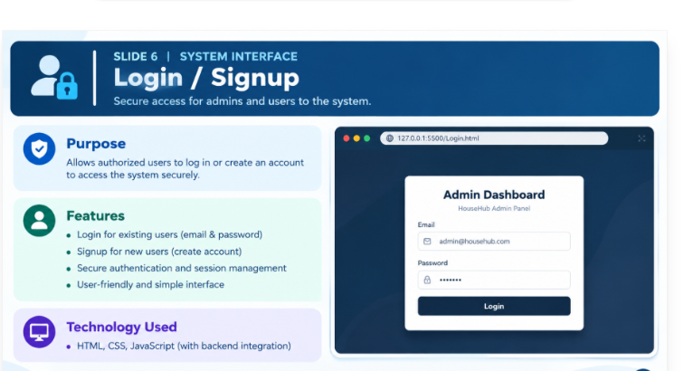

Slide 8
SLIDE 7 | MEMBER 2 — FOUJIA AKTHER (202204009)
Property Listings & Image Management
Add New Listing
Owner fills title, description, location, monthly price, room type (single room / full house / mess), number of bedrooms, and amenities such as Wi-Fi, gas or parking.
Edit & Delete
Owner can update any field of their listing at any time. Only the listing owner can edit it. Admin can also delete any listing from the system.
Image Upload
Owner uploads one or more property photos using the Multer middleware. Images are saved on the server and linked via the listing_images table.
Listing Details Page
A full-page view showing the image gallery, all property information, average rating, and owner contact details — visible only after the tenant interest request is accepted.
Status Tracking
Each listing has a status field (available / unavailable). Owner can toggle it without deleting the listing, allowing seasonal or temporary hold.
Notes:
Member 2 builds the core listing CRUD that is the heart of the platform.

Slide 9
SLIDE 8 | DATABASE
Database Design — 5 Core Tables
Table Name
Key Fields
Built By
users
id, name, email, password (hashed), phone, role
All Members
listings
id, owner_id (FK), title, location, price,
room_type, bedrooms, status
Member 2
listing_images
id, listing_id (FK), image_url
Member 2
requests
id, listing_id (FK), tenant_id (FK),
status (pending / accepted / rejected)
Member 3
wishlist
id, tenant_id (FK), listing_id (FK), created_at
Member 3
FK = Foreign Key | Passwords stored as bcrypt hash — never plain text | UNIQUE constraint prevents duplicate requests / wishlist entries
Notes:
Relational schema with proper foreign keys. Mention normalization and security.

Slide 10
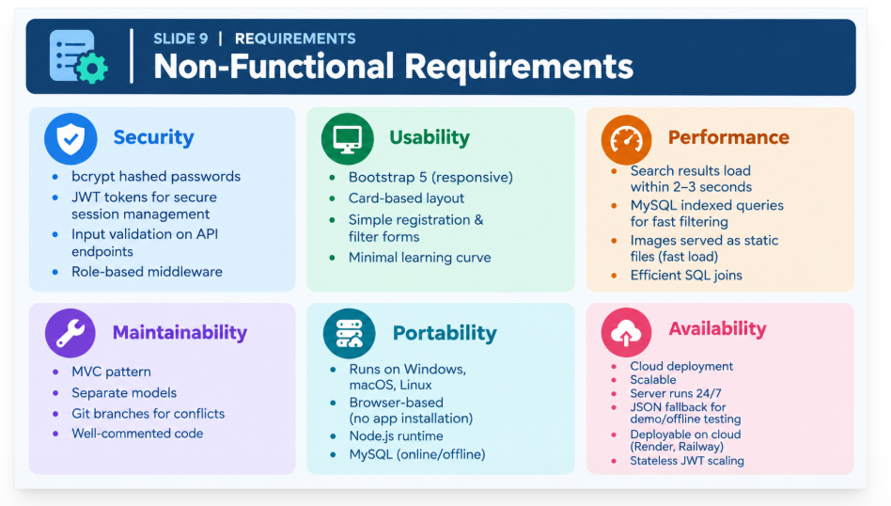

Slide 11
SLIDE 10 | MEMBER 3 — MANSORA AKTHER MIM (202104028)
Search, Request System & Wishlist
Search & Filter System
Tenant can filter all available listings by: Location (partial text match), Price range (minimum and maximum), Room type (single room, full house, mess) and a general Keyword that searches title, description and location at once.
Interest Request System
Tenant clicks "I am Interested" on any listing. A request record is created with status Pending. The owner sees all incoming requests on their dashboard and clicks Accept or Reject. On acceptance, the tenant gains access to the owner contact details.
Wishlist — Save for Later
Tenant can bookmark any listing using a heart/save button on the listing card. The button toggles: clicking again removes the listing. A "My Saved Listings" page shows the full wishlist so the tenant can revisit and compare options easily.
Notes:
Member 3 builds the discovery and communication layer — the features tenants use most.

Slide 12
SLIDE 11 | MEMBER 3 — API ROUTES
Search, Request & Wishlist API Endpoints
Method
Endpoint
Description
GET
/api/search
Search and filter listings — public
GET
/api/search/:id
Full details of one listing
POST
/api/requests
Tenant sends interest request (tenant only)
GET
/api/requests/my-requests
Tenant views own request history
GET
/api/requests/owner-requests
Owner sees all requests on their listings
PUT
/api/requests/:id
Owner accepts or rejects a request
DELETE
/api/requests/:id
Tenant cancels a pending request
GET
/api/wishlist
Get all saved listings for tenant
POST
/api/wishlist/:id
Toggle save / remove for a listing
GET
/api/wishlist/check/:id
Check if a listing is saved (button state)
Notes:
Search is fully public. Request and Wishlist routes require a Tenant JWT token.

Slide 13
SLIDE 12
Frontend + Backend + User Interface
How HouseHub turns user actions into working pages and APIs
Main Pages / Scenario
Application Flow
LOGIN
SEARCH LISTINGS
DASHBOARD
FRONTEND
Email
Location | Price
My Listings / Requests
HTML/CSS • Bootstrap 5 • JavaScript / Fetch API
Password
Room Type
Wishlist / Status
Role: Owner / Tenant
Property Cards
Admin: Users + Listings
↓
LOGIN
SEARCH
OPEN
BACKEND
Node.js • Express.js • REST APIs • MVC
LISTING DETAILS
REQUEST STATUS
Photo gallery
Pending → Owner review
↓
Rent • rooms • location
Accepted → contact visible
DATABASE
I am Interested ♥
Rejected → request closed
MySQL • users • listings • requests • wishlist
INTERESTED
STATUS
HouseHub • Software Engineering
Netrakona University

Slide 14
SLIDE 13
How HouseHub Satisfies Software Engineering
Project lifecycle mapped to lecture concepts and the selected development model
Five Models in the Lecture — HouseHub Choice
Software Engineering Practices
• Requirement engineering: identify Owner, Tenant and Admin needs.
Waterfall
Sequential phases
Rigid for changing requirements
• Feasibility + analysis: define scope, roles, database and technology.
Spiral
Risk-driven iterations
More complex for this project
• Software design: use case model, architecture and relational database.
• Coding: modular Express/MVC backend + responsive frontend.
Prototyping
Early UI feedback
Useful during UI understanding
• Testing: API and feature-level test cases before release.
Iterative / Incremental
Small releases
Matches feature-by-feature work
• Project management: Git/GitHub, task division, schedule and dependencies.
• Maintenance/future scope: extend the system as requirements evolve.
Agile
Iterative + incremental + feedback
Selected approach
Selected: Agile — develop small increments, review feedback, then refine the next increment.
HouseHub • Software Engineering
Netrakona University

Slide 15
SLIDE 14
Use Case Model + Software Design
How the main actors interact with HouseHub and how the system is structured
Use Case Model
Software Design (3 Layers)
HOUSEHUB SYSTEM
○
Presentation Layer
Register / Login
Search & Filter
HTML • CSS • Bootstrap • JS
Tenant
↓
○
Manage Listings
Wishlist
Application Layer
Express routes • controllers • JWT • middleware
○
↓
Send Interest
Accept / Reject
Admin
Data Layer
MySQL • tables • foreign keys • queries
Owner
View Contact
Admin Control
Frontend → REST API → Database → Response
HouseHub • Software Engineering
Netrakona University

Slide 16
SLIDE 15
Software Project Management — Schedule & Dependencies
A compact project plan using the lecture's Gantt and PERT concepts
Gantt / Bar Chart
Activity Network / Predecessor
1
2
3
4
5
6
7
8
9
10
Requirements (2d)
A: Requirements • 2d
B: UI + Prototype • 2d
Pred: —
Pred: A
UI + Prototype (2d)
Database Design (2d)
C: Database • 2d
D: Backend APIs • 3d
Pred: A
Pred: C
Backend APIs (3d)
Frontend Integration (2d)
E: Integration • 2d
Pred: B,D
Testing (2d)
GitHub + Final (2d)
F: Testing • 2d
Pred: E
Illustrative planning periods; dependency order is the key idea.
Example: Integration waits for both UI and Backend.
HouseHub • Software Engineering
Netrakona University

Slide 17
SLIDE 16
Testing — Simple Test Case View
Test cases connect requirements to observable results before the final release
TC ID
Feature / Input
Expected Result
Status
TC-01
Login with valid email/password
JWT is issued and user reaches the correct role dashboard.
Pass
TC-02
Search by location + price range
Only matching available listings are returned.
Pass
TC-03
Tenant sends interest request
Request is created with Pending status.
Pass
TC-04
Owner accepts a request
Request becomes Accepted; tenant can see owner contact.
Pass
TC-05
Tenant toggles wishlist
Listing is saved once and removed when toggled again.
Pass
TC-06
Non-owner edits another listing
API rejects unauthorized update.
Pass
Core scenarios: authentication, search, request flow, wishlist and authorization.
HouseHub • Software Engineering
Netrakona University

Slide 18
SLIDE 17 | FEATURES
All System Features at a Glance
Register & Login
M-1
Post Listings
M-2
Sign-up, JWT, role selection
Title, photos, price, room type
Search & Filter
M-3
Listing Details
M-2
Location, price, type, keyword
Gallery, info, contact on approval
Interest Request
M-3
Wishlist
M-3
Send, accept, reject, cancel
Save, remove, view saved listings
Admin Panel
M-1
Review & Rating
M-All
Users, listings, block, remove
Star rating after confirmed rental
M-1 = Member 1 | M-2 = Member 2 | M-3 = Member 3 | M-All = All Members collaborate
Notes:
The badge shows which member built each feature. Use this slide to confirm full coverage.

Slide 19
SLIDE 18 | CLOSING
Future Scope & Conclusion
Google Maps
Real-time Chat
Online Payment
Verified Badge
Show listing location on an interactive map so tenants can judge distance and neighbourhood.
Owner and tenant can message each other directly using Socket.IO after a request is accepted.
Advance booking via bKash or SSLCommerz so tenants can confirm a room without meeting first.
NID verification for owners gives tenants confidence that the listing is legitimate and safe.
Conclusion
HouseHub demonstrates the complete software engineering lifecycle — from requirements gathering and SRS documentation through database design, MVC backend development, frontend implementation, API testing and collaborative GitHub-based version control. The three-module division gives each member clear ownership, and the JWT security layer, role-based access, and relational database design reflect industry-level practices. The platform is ready for cloud deployment and can be extended with the future features described above.
Thank you | Submitted to: Abdullah Al Siam | Netrakona University
Notes:
Close confidently. Invite questions. Each member should be able to answer questions about their own module.

Slide 20
THANK YOU
Any question ??

